Slide 1
Ocean Data Interoperability Platform (ODIP): developing a common framework for marine data management on a global scale
Helen Glaves¹ and Dick Schaap²
1 British Geological Survey, United Kingdom
2 MARIS, The Netherlands

Slide 2
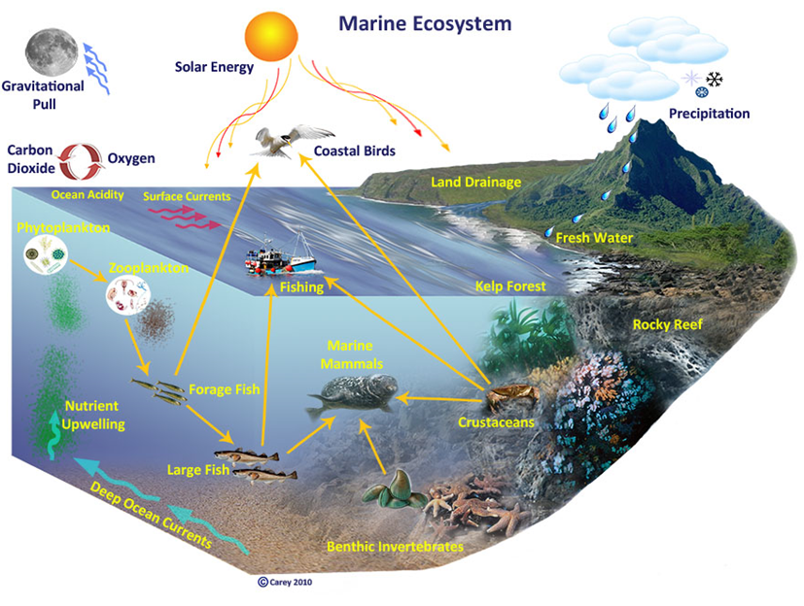
Drivers of the ecosystem approach to marine research (A European perspective)
Policy
Marine Strategy Framework Directive
EU Marine Knowledge 2020
Galway Agreement
Economic/scientific
assessments of ecosystem health
evaluation of the impacts of specific factors/ activities on an ecosystem
forecasting future change to support sustainable use of the marine environment
Requires large volumes of data that are:
multidisciplinary
high quality
well documented
interoperable
Notes:
Shift from traditional single discipline science to a more multidisciplinary, ecosystem based approach to marine research.
The importance of the diverse range of data in all aspects of marine research, assessment and planning is emphasized in Europe by a number of directives and communication from the European Commission including:
the Marine Strategy Framework Directive 2008 (MSFD),
EU Marine Knowledge 2020
EU/US/Canada agreement on Atlantic ocean research: Galway agreement
Marine monitoring is essential for assessing the health of a particular ecosystem and for assessing the impacts of specific factors and activities on it. Data is fundamental to carrying out these marine ecosystem assessments and making forecasts of potential future changes to support sustainable use of the marine environment and the ecosystem services it delivers
An approach that requires large volumes of interoperable data to be readily available to the user from a range of disciplines, organisations and sources.

Slide 3

Barriers to interoperable marine data
Highly heterogeneous
Collected
By large number of organisations/ institutes etc.
Using wide range of sensors mounted on a variety of platforms
Different formats and standards
Coordinate systems (projected or geographic/global and local)
Metadata standards (global, regional, national)
Data formats (including proprietary)

Slide 4

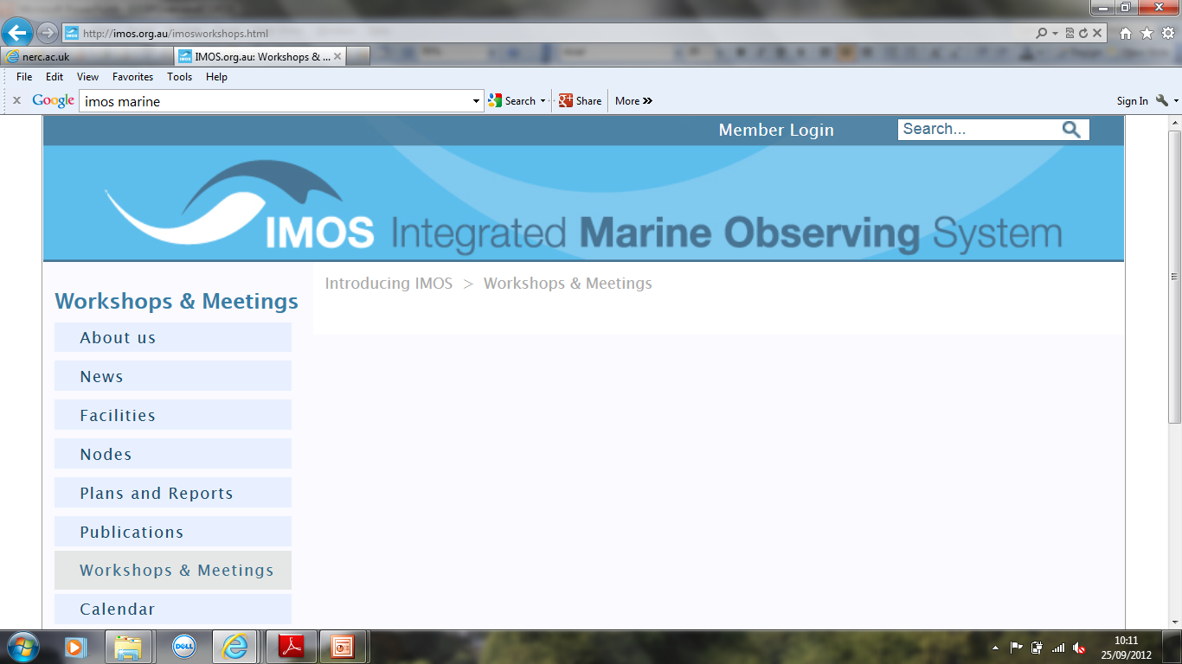
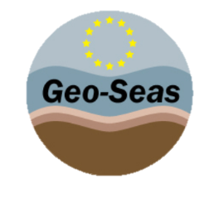


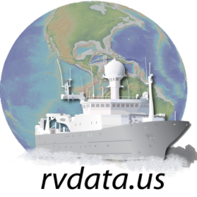
Regional data infrastructures
Australia
Initiatives to develop marine data infrastructures
BUT
Implemented according to specific user community requirements and priorities
Aligned to funding agency policies
Europe
USA

Slide 5
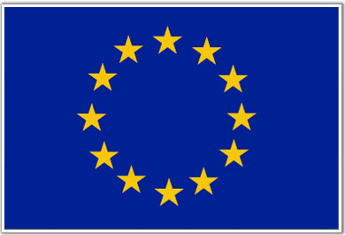


Ocean Data Interoperability
Platform (ODIP/ODIP II)
European-USA-Australia collaborative project
Funded in parallel by:
European Commission
National Science Foundation (NSF)
Australian Government
ODIP: October 2012 – September 2015
ODIP II: April 2015 – March 2018

Slide 6


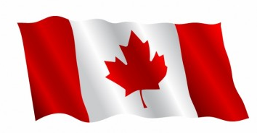
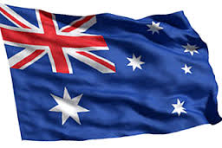
ODIP: Objectives
Develop a common global approach to marine data management that can be extended to other regions / data infrastructures beyond the participating geographical regions
Establish a European - USA - Australia-Canada co-ordination platform to promote dialogue between regional marine data infrastructures
Demonstrate this coordinated approach by establishing interoperability between exiting regional marine data infrastructures and with global systems

Slide 7
How ODIP is achieving its objectives?
Creating a collaborative environment for organised dialogue between partners
Regular joint workshops: project partners and other relevant experts
Creating and publishing inventories of existing relevant standards , best practice and policies
Development of prototypes for testing and evaluating potential interoperability solutions

Slide 8
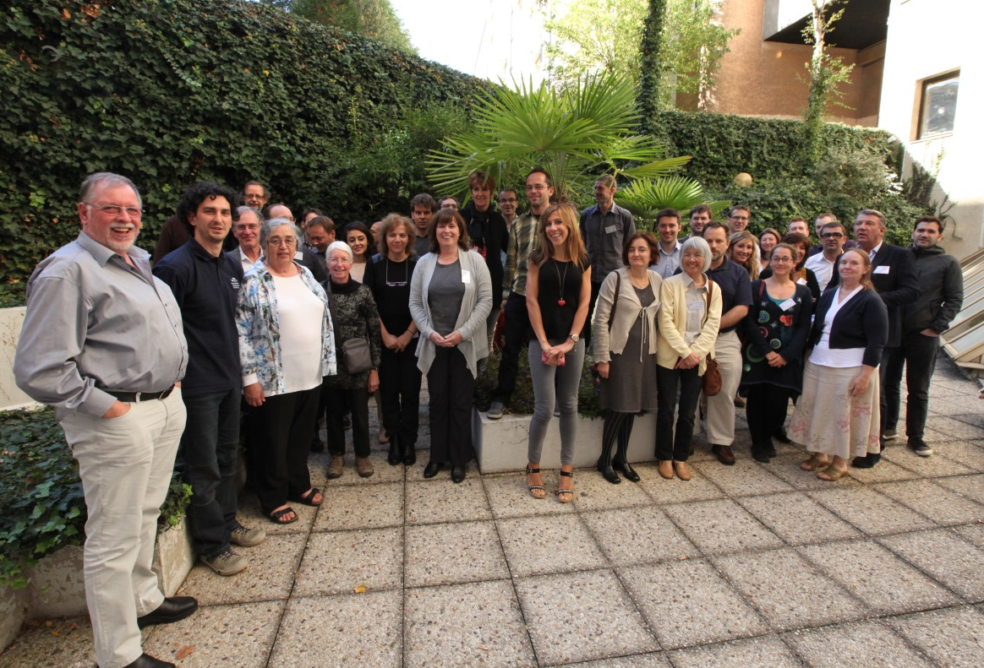
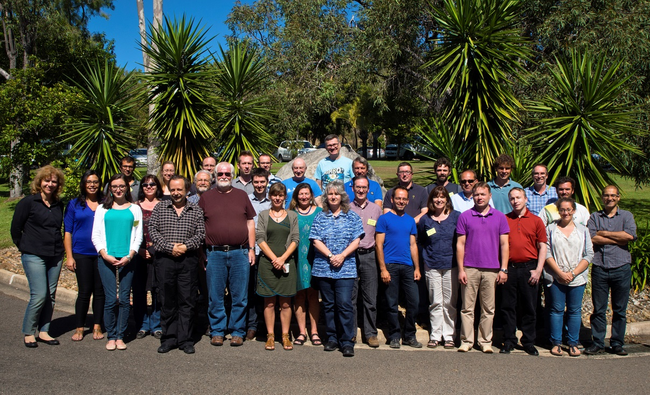
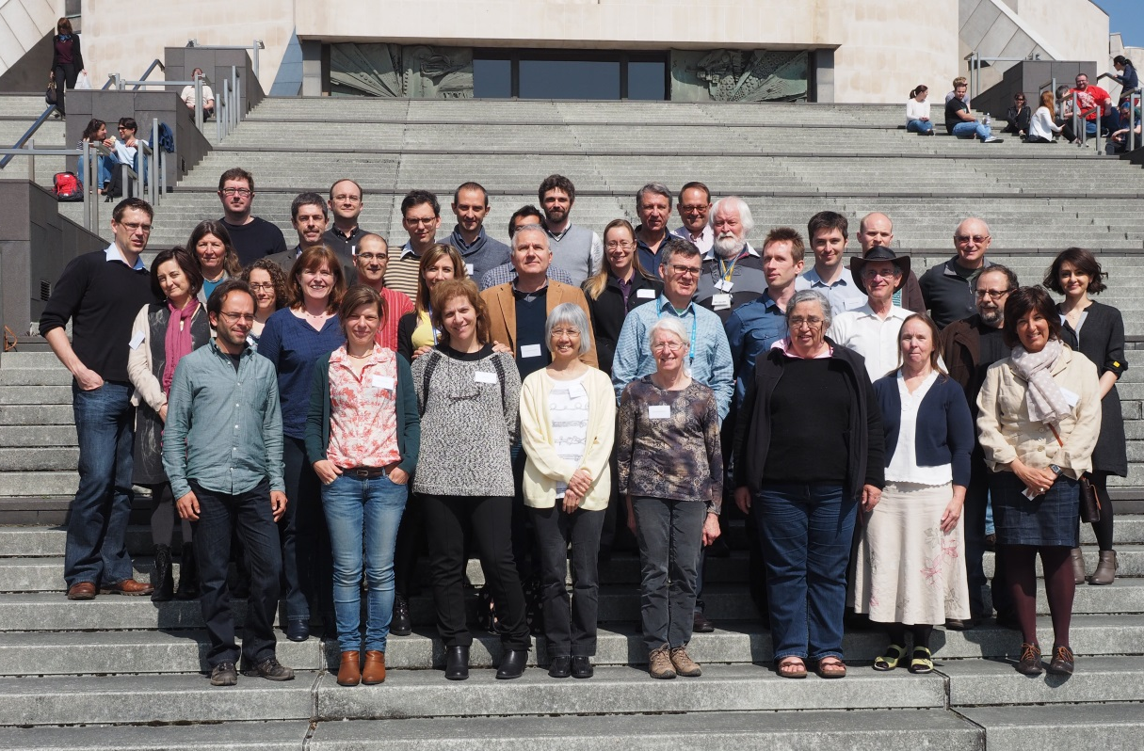

Slide 9
How ODIP is achieving its objectives?
Collaboration platform for organised dialogue between regional marine data infrastructures
Regular joint workshops: partners and other relevant experts
Creating and publishing inventories of existing relevant standards, best practice and policies
Development of prototypes for testing and evaluating potential interoperability solutions

Slide 10


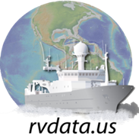
ODIP 1
Establishing interoperability between regional marine data discovery and access services :
SeaDataNet, (Europe)
AODN (Australia)
US NODC (USA)
Using EuroGEOSS GEO-DAB brokering services
Facilitate sharing of metadata
across regional data infrastructures
with global GEOSS portal and IODE Ocean Data Portal (ODP)

Slide 11
ODIP 1: progress
Regional data discovery and access service delivering ‘collections’ of XML metadata records as web services
Harvested by GEO-DAB broker and converted to Common Reference Schema
Broker exposes standardised ‘collections’ metadata as web services
OIA-PMH: harvested by IODE-Ocean Data Portal (ODP)
CSW: harvested by GEOSS portal
Metadata from regional data discovery systems accessible via global portals
11

Slide 12
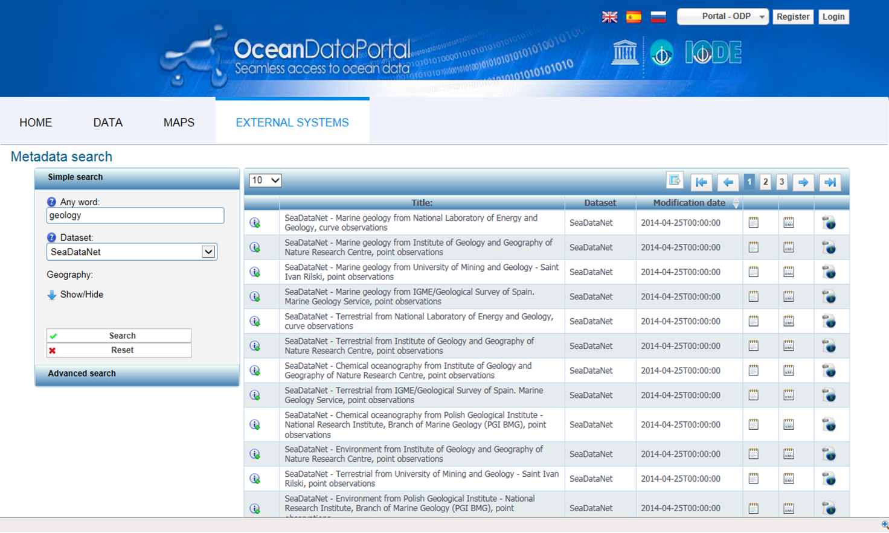
12
Notes:
SeaDataNet records exposed in Ocean Data Portal
UNESCO’s International Oceanographic Data and Information Exchange (IODE) programme for the "Intergovernmental Oceanographic Commission" (IOC)

Slide 13
ODIP 2
Establishing interoperability across cruise summary reporting (CSR) systems in Europe, the USA and Australia, and with the Partnership for Observing the Global Oceans (POGO) portal
Improvement of delivery and exchange of cruise summary information through the use of common formats and vocabularies
Using GeoNetWorks for routine harvesting of cruise data from the regional cruise summary reporting systems

Slide 14
ODIP 2: progress
SeaDataNet CSR (Cruise Summary Report) 3.0 schema adopted by:
R2R consortium partners (USA)
Marine National Facility (Australia)
Deployment of GeoNetwork catalogues providing a GUI (web portal) and API (CSW service) at regional nodes
ISO Cruise Summary Reports harvested from regional nodes and exposed in the POGO portal

Slide 15
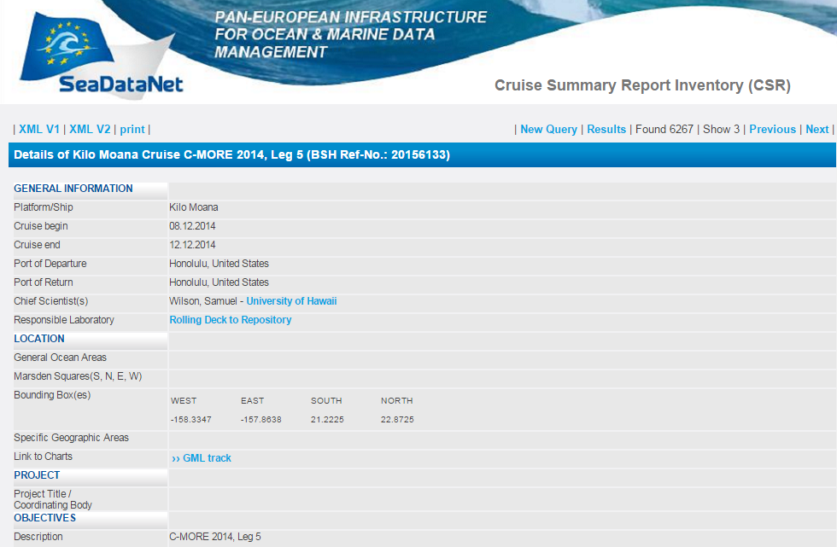
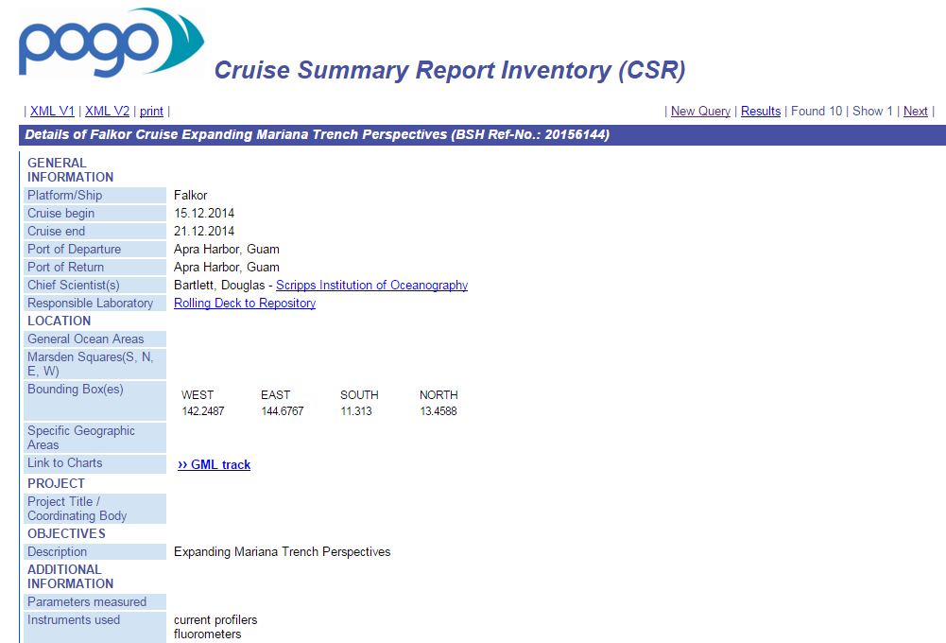
ODIP 2: progress

Slide 16
ODIP 3
Establishment of a prototype for a Sensor Observation Service (SOS) for selected sensors installed on vessels and in real-time monitoring systems using sensor web enablement (SWE)
progress regional initiatives towards the adoption of SWE allowing direct standardised access to the data from operational sensor systems

Slide 17
ODIP 3: progress
Multiple initiatives in the marine domain addressing some aspect of SWE:
Europe research projects for observing systems (EuroFleets, JERICO FixO3, AtlantOS, GROOM), data management (SeaDataNet ); instruments and sensors (Sense OCEAN, NEXOS, and SCHeMA),
USA major implementations of SWE in US-IOOS programme
initiatives including SWE in Australia
Community of practice established
Notes:
SWE for SOS: Not sufficiently mature to move towards a common SWE standard

Slide 18
What next?
ODIP II: Extending the Ocean Data Interoperability Platform
Continue and extend the activities of the existing ODIP project
Expand the scope of ODIP to cover other domains e.g. marine biology, and include additional partners
Continued support of the coordination platform to facilitate the establishment of interoperability between regional data infrastructures in Europe, USA and Australia and also with global systems e.g. IODE- ODP, GEOSS, POGO
Develop common approaches for specific aspects of marine data management e.g. vocabularies, formats, sensor web enablement etc.
Development of existing and further prototype interoperability solutions

Slide 19




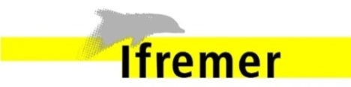





Partners
Europe: 10 EU-funded partners (6 countries)
NERC-BGS/BODC, MARIS, OGS, IFREMER, HCMR, ENEA, ULG, CNR, RBINS, TNO

Slide 20









Partners
Europe: 19 EU-funded partners (9 countries)
NERC-BGS/BODC, MARIS, OGS, IFREMER, HCMR, ENEA, ULG, CNR, RBINS, TNO, AWI, BSH, RIHMI-WDC, VLIZ, UniHB, CSIC, 52^{O}North, IEEE, SOCIB

Slide 21
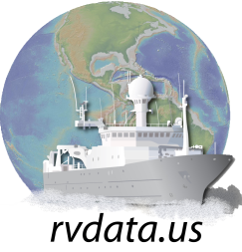
Contributors
USA
Scripps Institution of Oceanography (SIO)
Woods Hole Oceanographic Institute (WHOI)
Lamont-Doherty Earth Observatory (LDEO),
Florida State University (FSU): Center for Ocean-Atmospheric Prediction Studies
NOAA
US-IOOS
UNIDATA
MMI
ESRI

Slide 22

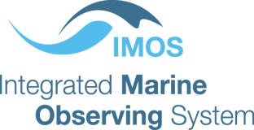







Australia:
University of Tasmania (IMOS)
CSIRO
Geoscience Australia (GA)
NCI
ANDS
International:
UNESCO IOC-IODE
GEO / GEOSS
POGO
ICSU – WDS
Contributors

Slide 23
What next?
ODIP II: Extending the Ocean Data Interoperability Platform
Continue and extend the activities of the existing ODIP project
Expand the scope of ODIP to cover other domains e.g. marine biology, and include additional partners
Continued support of the coordination platform to facilitate the establishment of interoperability between regional data infrastructures
Develop common approaches for specific aspects of marine data management e.g. vocabularies, formats, sensor web enablement etc.
Development of existing and additional prototype interoperability solutions

Slide 24

http://www.odip.eu
hmg@bgs.ac.uk

